Slide 1
ExpenseTracker:
From Expenses to Conversations
Venkateswarlu Nagineni
Quan Nguyen
Pradeep Periyasamy
Amesh Shrestha
CSCE 606 - Project 2

Slide 2
The Application – Who & What
Group Members:
roommates, friends, or colleagues sharing & wanting to manage financial activities together
Client/
End-users:
Spender:
just anyone who wants to record and manage their personal or group expenses.

Slide 3
The Application - Who & What
What problems does it solve?
  Helps users log, view, and organize personal and shared expenses
  • Enables direct private communication between users about expenses
  • Simplifies account management with secure login, Google OAuth, and backup/restore.
How does it solve those problems?
  Provides full authentication and account lifecycle management (signup, login, password reset, deletion)
  • Allows users to create, edit, and manage expenses and groups
  • Enables private conversations linked to expenses or shared groups
  • Provides backup and restore features for expense data with clear user instructions.

Slide 4




System Design - Key Components
External Service: Google Oauth for authentication/account management
Frontend: HTML/ERB views, [INSERT SOMETHING ELSE HERE]
Backend: Ruby on Rails MVC framework.
External Service:
Google Cloud for sending emails to users
Database: PostgreSQL

Slide 5
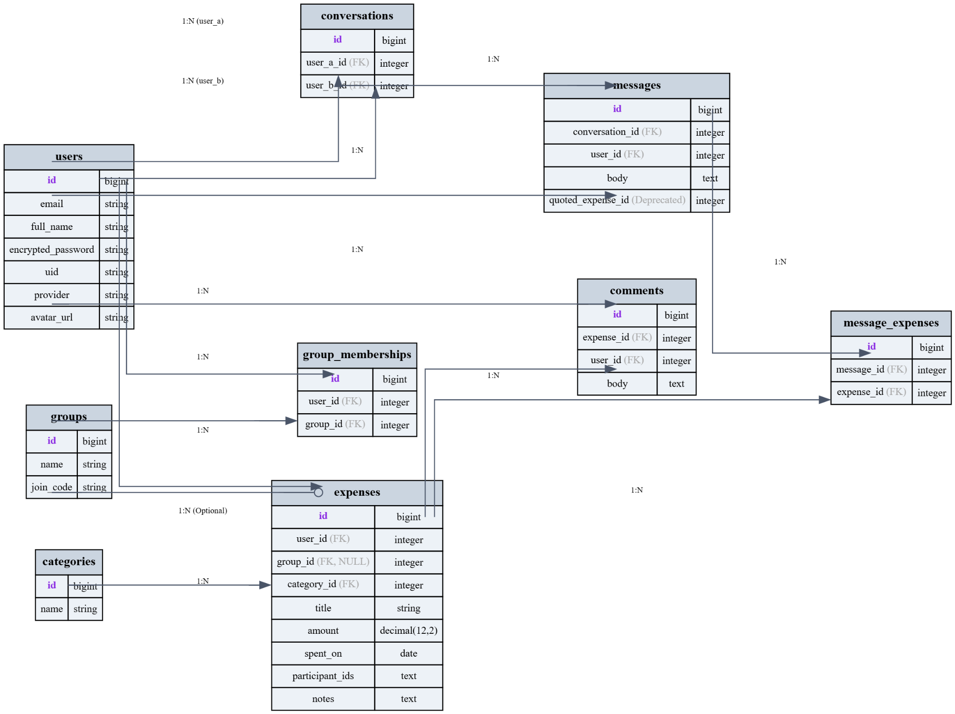
Database Design Diagram

Slide 6
Database Design Model (in words)
One to many relationship between [INSERT MODELS]
Many to many relationship between [INSERT MODELS]
One to many relationship between [INSERT MODELS]

Slide 7
Frameworks & Tools Used
Ruby on Rails: Model View Controller Framework
PostGreSQL: Relational Database System
Rspec for unit tests
Cucumber for acceptance tests
Capybara for system tests
AI Integration: OpenAI API
Frontend: Hotwire (Turbo) with Tailwind CSS (via CDN)
Deployment: GitHub Actions (CI), Heroku (Production)

Slide 8


Design Patterns Used
MVC (Model-View-Controller): Core Rails pattern for separation of concerns.
Service Object Pattern: Used for backup/restore JSON handling and OAuth authentication to keep controllers lightweight.

Slide 9
System Design - Major Design Choices & Justification
CHOICES | JUSTIFICATIONS
Progressive Enhancement / No-JS Fallback | Ensures core functionality ([INSERT FUNCTIONALITIES HERE]) works for all users, regardless of JavaScript availability. This improves accessibility and reliability.
Devise for Authentication | Simplifies implementation of secure user management, Google OAuth, and password resets.
Conversations & Messages Models | Enables scalable private chat-like communication with expense quoting.
Backup/Restore via JSON | Portable, human-readable data format; simplifies testing and versioning.

Slide 10
[INSERT ALL ROUTES HERE WITH REAL UI IMAGES]
[MULTIPLE SLIDES]

Slide 11
[INSERT ALL ROUTES HERE WITH REAL UI IMAGES]
[MULTIPLE SLIDES]

Slide 12
[INSERT ALL ROUTES HERE WITH REAL UI IMAGES]
[MULTIPLE SLIDES]

Slide 13




UI/UX Design - Design Principles Applied
Separate Pages for each developer’s features: Allows developers to work independently speeding up the development.
Seamless Navigation: Navbar links for “Expenses,” “Groups,” “Conversations,” and “Backup” are all available.
Consistency: Uniform button styles, forms, and flash messages throughout the app.
Progressive Disclosure: Expense details and quoted expenses within messages shown only when relevant.

Slide 14
AI Tool Usage
– ChatGPT:
Code Explanation & Debugging: To understand complex error messages and suggest fixes for RSpec and Cucumber tests.
Boilerplate Generation: For generating standard Rails controller actions and model specs.
Idea Validation: For inquiring about the idiomatic way of doing stuff in ruby.
– [ADD ALL AI YOU USED HERE]

Slide 15
Challenges & Lessons Learned
Challenge 1: Complex User Stories Integration
Problem: Over 25 stories involving authentication, messaging, and backup interactions caused merge conflicts and accidentally reverted features.
Lesson: Break large epics into smaller, well-isolated PRs for faster, safer merges.
Challenge 2: Authentication Edge Cases
Problem: Handling both Devise (email/password) and Google OAuth workflows cause conflicts between accounts created via one of these two separate methods but then attempted to log in via the other.
Lesson: Modify Devise Omniauth callbacks controller to handle the merge logic.

Slide 16



Future Plans & Opportunities
MOBILE RESPONSIVE UI:
OPTIMIZE CONVERSATION AND EXPENSE MANAGEMENT FOR MOBILE DEVICES.
ENHANCED NOTIFICATIONS:
ADD REAL-TIME ALERTS FOR NEW MESSAGES OR GROUP INVITATIONS.
EXPENSE ANALYTICS:
ADD VISUAL SUMMARIES OF SPENDING TRENDS PER GROUP OR CATEGORY.
CLOUD BACKUP INTEGRATION:
SUPPORT GOOGLE DRIVE OR DROPBOX FOR BACKUP AND RESTORE OPTIONS.

Slide 17


